Slide 1
Data Preparation

Slide 2
Overview
Exploratory Data Analysis
Imputation
Feature Engineering

Slide 3



Exploratory Data Analysis
Data
Explore
Understand
Notes:
Explore and understand data in a systematic way

Slide 4
Exploratory Data Analysis
2. Visualisations & Summary Statistics
3. Univariate & Bivariate Analysis
1. Generate questions
Notes:
Iterative process
When you start you won’t know what questions to ask
But you should have a general idea what your data is
In our case we are looking at the titanic dataset and we are interested in the survival rate
Want to keep in mind of factors such as age? Family? Gender? Etc? Cabin Floor?
Next we want to visualize our variables in the dataset and essentially look for answers to these questions
We can do basic distribution plots, summary statistics, univariate or bivariate analysis
Always come back to EDA and try and answer questions by manipulating the data

Slide 5
Exploratory Data Analysis
Generate Questions
Notes:
Do younger people have a higher survival rate?
Do females have a higher survival rate?
Does the cabin location matter?
Does a person’s socioeconomic status matter?
What about their embark location?
Also we need to think about correlations between explanatory variables → Multicollinearity

Slide 6
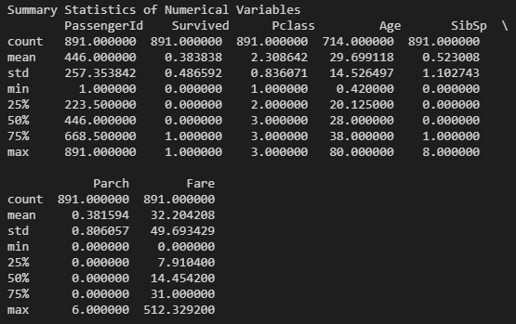
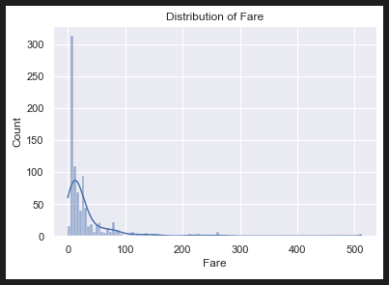
Exploratory Data Analysis
Summary Statistics
Visualisations
Notes:
First look at summary statistics
Move on to visualizing distributions of variables
For example, we see the fare variable is quite heavily right skewed

Slide 7
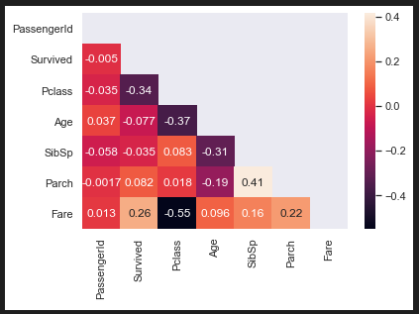
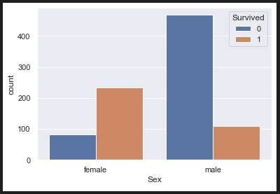
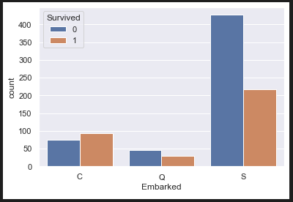
Exploratory Data Analysis
Univariate & Bivariate Analysis
Notes:
Now look at some correlation between variables
Especially look at survival rates against gender, place of embarkation, etc → try answer our questions we had in the first step of EDA
A correlation plot usually tells us a lot of information
From there we can do plots between variables if required for more in-depth analysis

Slide 8
Missing Data
Notes:
How to deal with missing data
Deletion?
Imputation?

Slide 9
Imputation
The process of replacing missing data by substituting values from some distribution.
Variable X | Variable X Imputed
50.2 | 50.2
10.7 | 10.7
NA | REPLACE
… | …
35.1 | 35.1
NA | REPLACE
11.9 | 11.9
Notes:
Basically replace missing data with some values drawn from somewhere else

Slide 10
Types of Imputation
Mean/Median imputation – Use mean/median of variable
Regression – Infer values via linear regression
Hot deck – Sample variable with replacement
Cold deck – Sample external dataset with replacement
Composite methods – Mixture of methods
Notes:
Mention that there are many types of imputation to fill out missing values

Slide 11
Hot Deck Imputation – Age Example
Simple
Advanced (Conditional Hot Deck)
Age
19
…
NaN
26
AgeNotNaN
19
…
26
There is a somewhat strong correlation between age and pclass
The older the person, the higher likelihood of a higher socio-economic status
Conditional hot deck imputation
Sub-set data into sub-categories
Impute missing data for each sub-category
Filter
AgeImputed
19
…
28
26
Age and Pclass Example
AgeNotNaN
19
…
26
Sample
Filter titanic data for each sub-class in a for loop
Subset Class 1 → Impute using subset
Subset Class 2 → Impute using subset
Subset Class 3 → Impute using subset
Notes:
Main one used throughout the Titanic analysis is hot deck
Hot deck ensures distribution remains similar since we are sampling with replacement
Mean/median imputation might not be good as favors the mean/median values and can distort distribution if lots of missing values being replaced
Regression can be used but need strong correlation b/w variables otherwise imputed values are bad

Slide 12
Feature Engineering
Notes:
Feature engineering is the process of using domain knowledge to extract features from raw data.
These features can be used to improve the performance of machine learning algorithms.

Slide 13
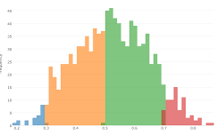
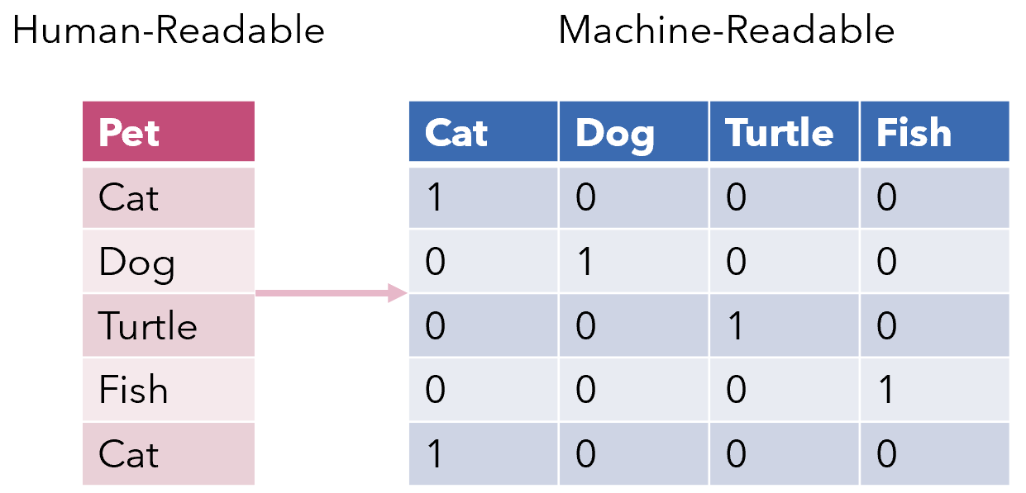
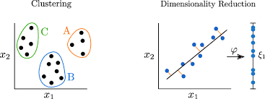


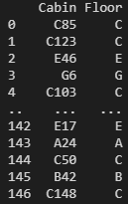
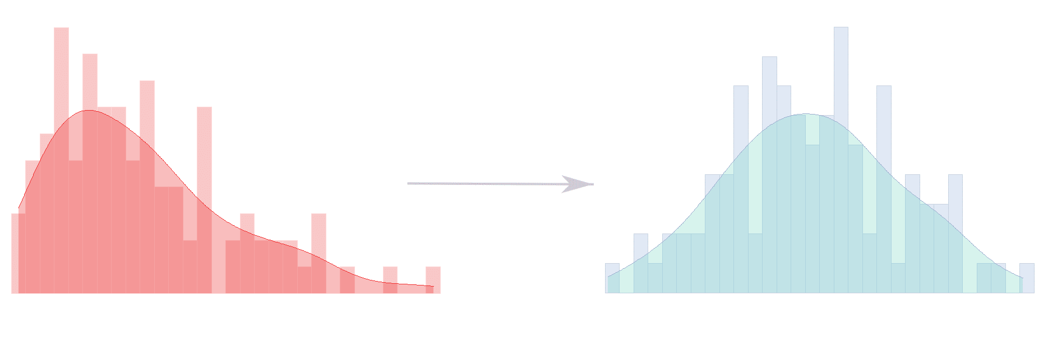
Feature Engineering
Data Binning
Encoding Methods
Dimensionality Reduction
Scaling
Extracting Strings
Requires domain knowledge to create useful features
Clustering
Log transformations
Extracting Time
Time | Day | Month | Year
2021/05/01 | 1 | May | 2021
Notes:
Explain the all the different types of techniques
Data binning – Converting a continuous variable into categories
One-hot encoding – Converting a categorical variable into binary variables
Dimensionality reduction – Reduce number of explanatory variables
Scaling – Self explanatory
Clustering – Reduce number of explanatory variables
Log transformations – Try and take care of skewness
Extracting info – Time is usually in some formatted string e.g. UTC, and we should convert these into more useful time measurements/features
– Sometimes generic strings can also be manipulated etc.

Slide 14
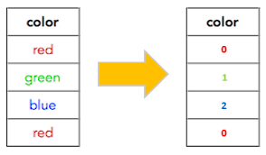
Encoding Methods
One-Hot Encoding – Nominal Data
Label Encoding – Ordinal Data

Slide 15
Summary
Exploratory Data Analysis
Imputation
Feature Engineering

